Slide 1
Intruder Notified via Mobile Image Using Sonar Sensor
CSE360 Project
Group Members:
14101003-Seevieta Biswas Toa
14101005-Samin Azhan
13201025-Nasrul Karim Sarker
13201047-Nafeem Haque

Slide 2
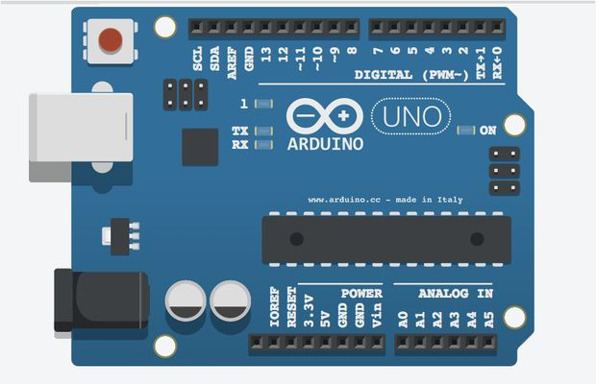
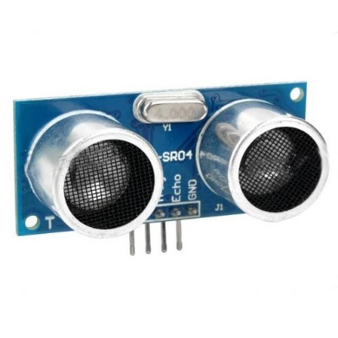
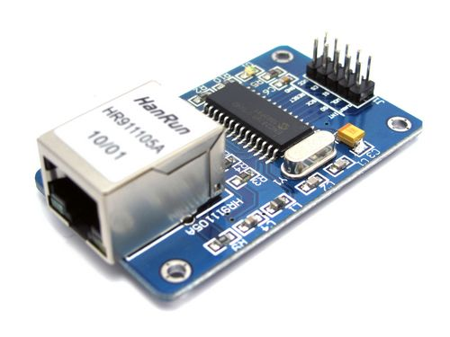
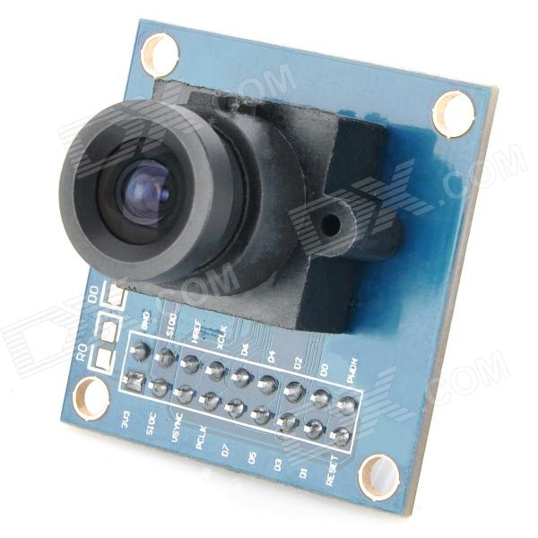
Components Required
Arduino
Sonar sensor
Camera module
Internet module

Slide 3
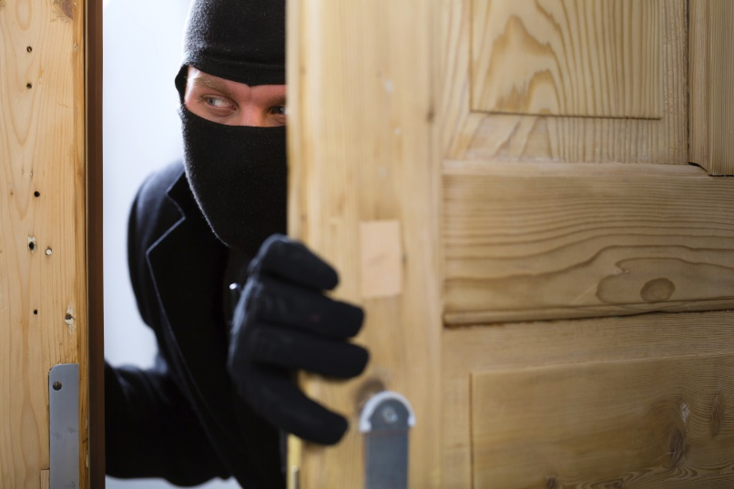


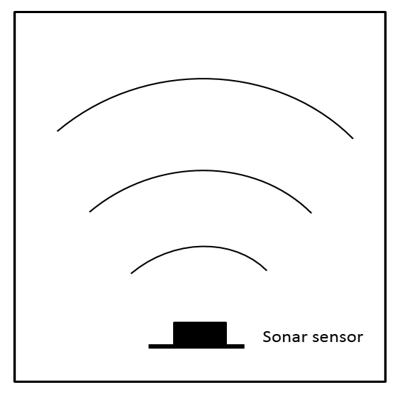


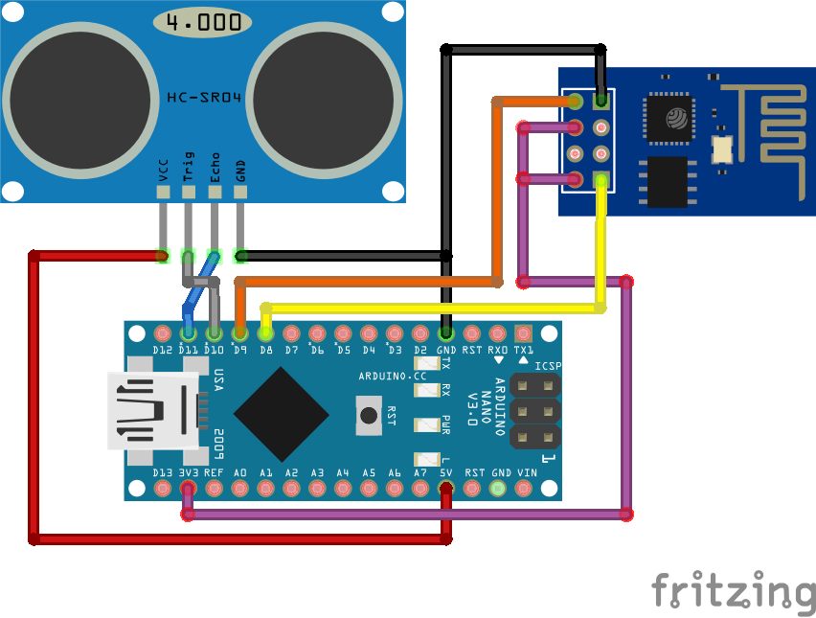

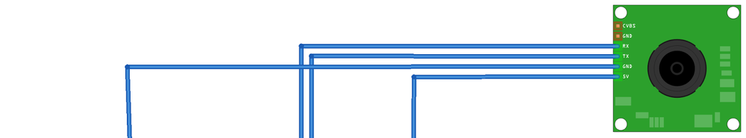

Slide 4

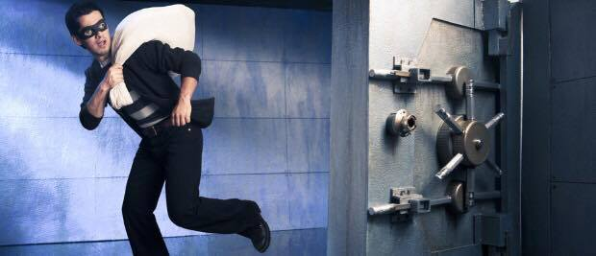

Usage
Banks
Residence
Restricted Areas
Any place that requires security

